Slide 1

An Efficient Knapsack-Based Approach for Calculating the Worst-Case Demand of AVR Tasks
Sandeep Kumar Bijinemula*, Aaron Willcock†,
Thidapat Chantem*, Nathan Fisher†
*Department of Electrical and Computer Engineering, Virginia Tech, USA
†Department of Computer Science, Wayne State University, USA
Notes:
collaboration

Slide 2
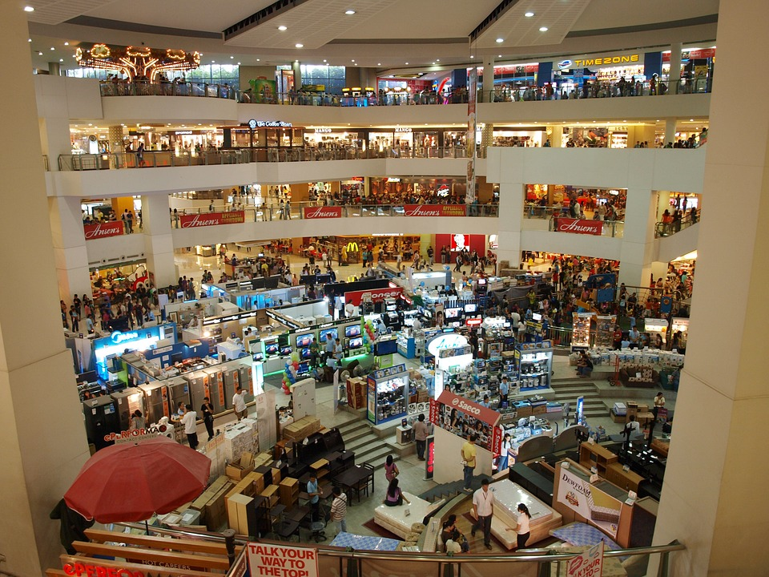
Holiday Thievery
Imagine your favorite store.
You have 100 seconds to take anything …for free
Where would you start?
What would you take?
Notes:
Media Markt. For those who recognize, this is akin to the typical knapsack problem.

Slide 3







Holiday Thievery
Goal:
Maximize value over 100 seconds
Increase value
Decrease time
$$<$$
$$<$$

Slide 4

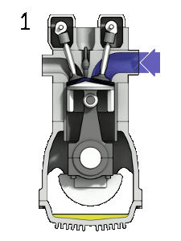
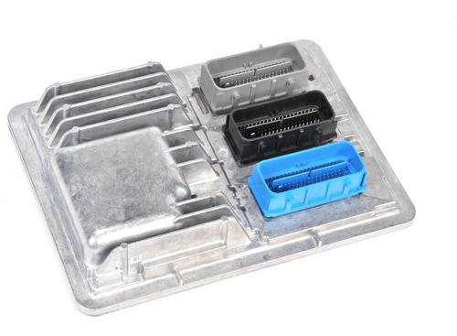



Holiday Thievery Function
Engine Control Module (ECM)
Value of Items
Image Provided by: Zephyris.
https://commons.wikimedia.org/wiki/
File:4StrokeEngine_Ortho_3D_Small.gif
Items per Second

Slide 5
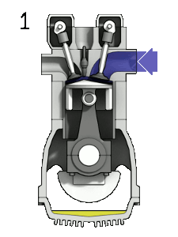
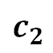
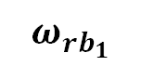
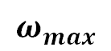
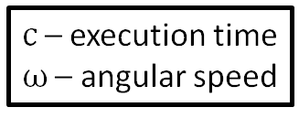
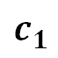
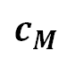
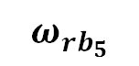
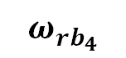
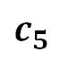
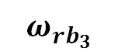
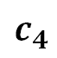
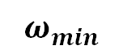
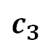
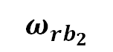
Engine Control: Adaptive Variable-Rate (AVR) Tasks
Holiday Thievery Function
Engine Control Module (ECM)
$$c_{1}$$
Execution Times of the Modes
Value of Items
$$c_{2}$$
$$c_{3}$$
$$c_{4}$$
Image Provided by: Zephyris.
https://commons.wikimedia.org/wiki/
File:4StrokeEngine_Ortho_3D_Small.gif
$$c_{5}$$
$$c_{M}$$
$$ω_{min}$$
$$ω_{{rb}_{1}}$$
$$ω_{{rb}_{2}}$$
$$ω_{{rb}_{3}}$$
$$ω_{{rb}_{4}}$$
$$ω_{{rb}_{5}}$$
$$ω_{max}$$
c – execution time
$ω$ – angular speed
Items per Second
Speeds
Biondi et al. [ICCPS ‘15]

Slide 6
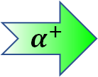

Engine Control: Adaptive Variable-Rate (AVR) Tasks
Jobs released at Top Dead Center (TDC)
Jobs due in one revolution (one full rotation)
$$c_{1}$$
Execution Times of the Modes
$$c_{2}$$
$$α^{+}$$
$$c_{3}$$
Higher rate of job release
$$c_{4}$$
Lower WCET per job
$$c_{5}$$
Higher rate of job release
Less time between job releases
$$c_{M}$$
$$ω_{min}$$
$$ω_{{rb}_{1}}$$
$$ω_{{rb}_{2}}$$
$$ω_{{rb}_{3}}$$
$$ω_{{rb}_{4}}$$
$$ω_{{rb}_{5}}$$
$$ω_{max}$$
c – execution time
$ω$ – angular speed
$$α^{+}$$
Speeds
Biondi et al. [ICCPS ‘15]

Slide 7
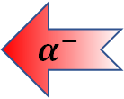
Engine Control: Adaptive Variable-Rate (AVR) Tasks
Jobs released at Top Dead Center (TDC)
Jobs due in one revolution (one full rotation)
$$c_{1}$$
Execution Times of the Modes
$$c_{2}$$
$$α^{−}$$
$$c_{3}$$
But how do we calculate worst-case demand?
Higher rate of job release
$$c_{4}$$
Higher WCET per job
$$c_{5}$$
Higher rate of job release
More time between job releases
$$c_{M}$$
$$ω_{min}$$
$$ω_{{rb}_{1}}$$
$$ω_{{rb}_{2}}$$
$$ω_{{rb}_{3}}$$
$$ω_{{rb}_{4}}$$
$$ω_{{rb}_{5}}$$
$$ω_{max}$$
c – execution time
$ω$ – angular speed
$$α^{−}$$
Speeds
Biondi et al. [ICCPS ‘15]
7
Notes:
These are real-time tasks which model the behavior of engine control tasks.
As engine speed increases, time between jobs decreases and WCET decreases.

Slide 8
Demand of AVR Tasks
Engine Control: Adaptive Variable-Rate (AVR) Tasks
Which point gives the worst-case demand?
$$c_{1}$$
Execution Times of the Modes
$$c_{2}$$
$$c_{3}$$
$$c_{4}$$
Calculation of worst-case demand is not straightforward.
$$c_{5}$$
$$c_{M}$$
$$ω_{min}$$
$$ω_{{rb}_{1}}$$
$$ω_{{rb}_{2}}$$
$$ω_{{rb}_{3}}$$
$$ω_{{rb}_{4}}$$
$$ω_{{rb}_{5}}$$
$$ω_{max}$$
c – execution time
$ω$ – angular speed
Speeds
Biondi et al. [ICCPS ‘15]
Notes:
These are real-time tasks which model the behavior of engine control tasks.
As engine speed increases, time between jobs decreases and WCET decreases.
We call the stretches of equal value "modes" or "steps" and the rightmost edge of the "step" a "right boundary".

Slide 9
Demand of AVR Tasks
$$c_{1}$$
Execution Times of the Modes
$$c_{2}$$
$$c_{3}$$
$$c_{4}$$
Calculation of worst-case demand is not straightforward.
$$c_{5}$$
$$c_{M}$$
$$ω_{min}$$
$$ω_{{rb}_{1}}$$
$$ω_{{rb}_{2}}$$
$$ω_{{rb}_{3}}$$
$$ω_{{rb}_{4}}$$
$$ω_{{rb}_{5}}$$
$$ω_{max}$$
c – execution time
$ω$ – angular speed
Speeds
Notes:
These are real-time tasks which model the behavior of engine control tasks.
As engine speed increases, time between jobs decreases and WCET decreases.

Slide 10
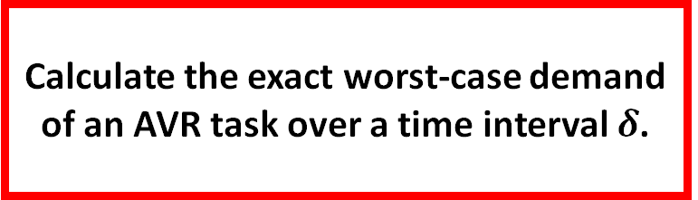
Motivation and Problem Statement
Demand of AVR Tasks
$$c_{1}$$
Motivation:
?
Execution Times of the Modes
Existing calculations of exact worst-case demand for AVR tasks are compute intensive.
$$c_{2}$$
$$c_{3}$$
$$c_{4}$$
Problem Statement:
$$c_{5}$$
Calculate the exact worst-case demand of an AVR task over a time interval $δ$.
$$c_{M}$$
$$ω_{min}$$
$$ω_{{rb}_{1}}$$
$$ω_{{rb}_{2}}$$
$$ω_{{rb}_{3}}$$
$$ω_{{rb}_{4}}$$
$$ω_{{rb}_{5}}$$
$$ω_{max}$$
c – execution time
$ω$ – angular speed
Speeds
Notes:
These are real-time tasks which model the behavior of engine control tasks.
As engine speed increases, time between jobs decreases and WCET decreases.

Slide 11



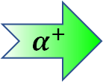
Approach & Contributions
1. Worst-case AVR task demand ↔ Bounded precedence constraint knapsack problem (BPCKP).
↔
2. Symmetric acceleration + Engine kinematics →
Reduced search space.
$$α^{−}$$
$$α^{+}$$
→
3. Results significantly outperform the state-of-the-art in computation time.
?
Notes:
"We make a simplifying assumption that magnitude of acceleration and deceleration is equal"

Slide 12
Outline
Approach and Contributions
Background & Related Work
Precedence Constraints & Search Space Reduction
Worst-Case AVR Demand as Knapsack Problem
Evaluation & Results
Conclusion & Future Work

Slide 13
Background & Related Work

Slide 14
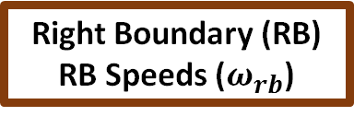
AVR Tasks – Speed or WCET?
$$c_{1}$$
+ Allows WCET to scale inversely with speed
? How can we calculate worst-case demand?
Execution Times of the Modes
$$c_{2}$$
$$c_{3}$$
$$c_{4}$$
Right Boundary (RB) RB Speeds ($ω_{rb}$)
$$c_{5}$$
Modes / Steps
$$c_{M}$$
$$ω_{min}$$
$$ω_{{rb}_{1}}$$
$$ω_{{rb}_{2}}$$
$$ω_{{rb}_{3}}$$
$$ω_{{rb}_{4}}$$
$$ω_{{rb}_{5}}$$
$$ω_{max}$$
c – execution time
$ω$ – angular speed
Speeds
Biondi et al. [ICCPS ‘15]

Slide 15
Digraph Real-Time (DRT) Approach
AVR Tasks – Speed or WCET?
+ Exact worst-case demand for a select set of speeds
? How can we compute worst-case demand faster?
$$c_{1}$$
Execution Times of the Modes
$$c_{2}$$
$$c_{3}$$
$$c_{4}$$
$$c_{5}$$
$$c_{M}$$
$$ω_{min}$$
$$ω_{{rb}_{1}}$$
$$ω_{{rb}_{2}}$$
$$ω_{{rb}_{3}}$$
$$ω_{{rb}_{4}}$$
$$ω_{{rb}_{5}}$$
$$ω_{max}$$
c – execution time
$ω$ – angular speed
Speeds
Mohaqeqi et al. [ECRTS ‘17]

Slide 16
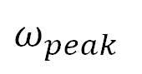
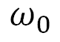
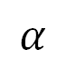
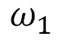
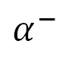
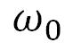
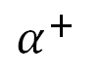
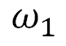
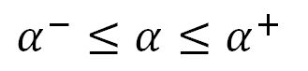
Related Works
Model – Adaptive-Variable Rate / Rhythmic Biondi et al. [ICCPS ‘15], Kim et al. [ICCPS ‘12]
Constant Acceleration between Jobs
Variable Acceleration between Jobs
Schedulability Guo and Baruah [ICCPS ‘15]
Exact Worst-case Demand Biondi et al. [ECRTS ‘14]
Exact Worst-case Demand via DRT Mohaqeqi et al. [ECRTS ‘17]
Exact Worst-case Demand via Knapsack
(This work)
$$α^{−}≤α≤α^{+}$$
$$ω_{peak}$$
$$α^{−}$$
$$α^{+}$$
$$α$$
$$ω_{1}$$
$$ω_{1}$$
$$ω_{0}$$
$$ω_{0}$$

Slide 17
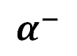
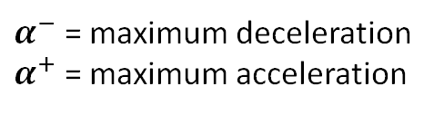
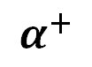
Related Works
Model – Adaptive-Variable Rate / Rhythmic Biondi et al. [ICCPS ‘15], Kim et al. [ICCPS ‘12]
Constant Acceleration between Jobs
Variable Acceleration between Jobs
Schedulability Guo and Baruah [ICCPS ‘15]
Exact Worst-case Demand Biondi et al. [ECRTS ‘14]
Exact Worst-case Demand via DRT Mohaqeqi et al. [ECRTS ‘17]
Exact Worst-case Demand via Knapsack
(This work)
$$α^{−}$$
$$α^{+}$$
$α^{−}$ = maximum deceleration
$α^{+}$ = maximum acceleration

Slide 18
Outline
Approach and Contributions
Background & Related Work
Precedence Constraints & Search Space Reduction
Worst-Case AVR Demand as Knapsack Problem
Evaluation & Results
Conclusion & Future Work
Notes:
Overview

Slide 19
Precedence Constraints & Search Space Reduction

Slide 20
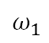
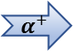
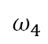
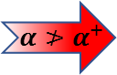
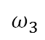
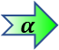
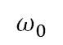
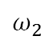
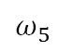
Acceleration Limits (on AVR)
$$c_{1}$$
$${ α≯α}^{+}$$
Execution Times of the Modes
$$c_{2}$$
$$c_{3}$$
$$α^{+}$$
$$α$$
$$c_{4}$$
$$c_{5}$$
$$c_{M}$$
$$ω_{0}$$
$$ω_{1}$$
$$ω_{2}$$
$$ω_{3}$$
$$ω_{4}$$
$$ω_{5}$$
$$ω_{min}$$
$$ω_{{rb}_{1}}$$
$$ω_{{rb}_{2}}$$
$$ω_{{rb}_{3}}$$
$$ω_{{rb}_{4}}$$
$$ω_{{rb}_{5}}$$
$$ω_{max}$$
c – execution time
$ω$ – angular speed
Reachable Speeds
Notes:
Consider the AVR graph that we are familiar from the previous slides.

Slide 21
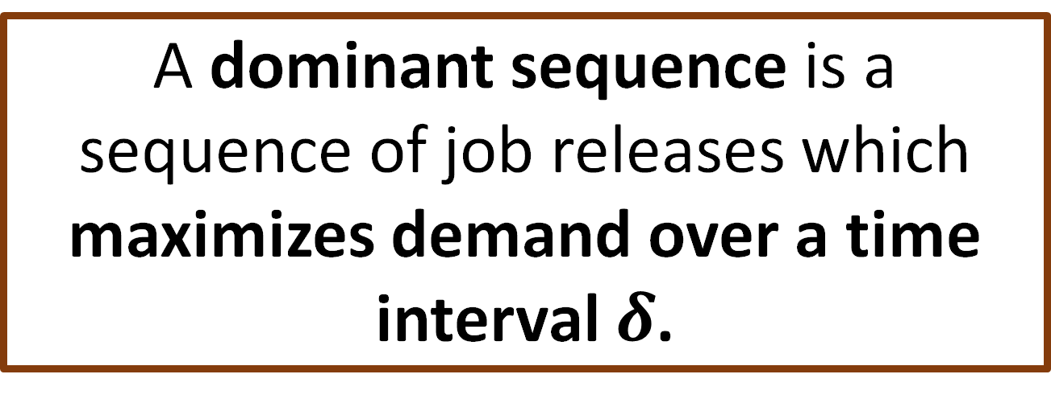
Search Space Reduction: Dominant Sequences
A dominant sequence is a sequence of job releases which maximizes demand over a time interval $δ$.
Notes:
To help us reduce the search space, we rely on the concept of “Dominant Sequences”. A dominant sequence is…

Slide 22
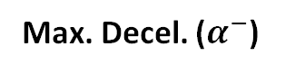
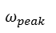
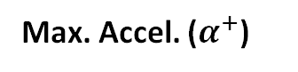
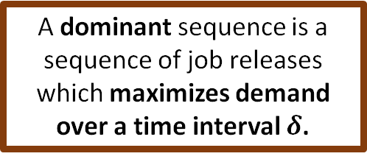
Dominant Sequence Visualized
Max. Accel. ($α^{+}$)
$$c_{1}$$
Execution Times of the Modes
Max. Decel. ($α^{−}$)
$$c_{2}$$
$$ω_{peak}$$
Var. Accel.
$$c_{3}$$
$$ω_{1}$$
$$ω_{0}$$
$$c_{4}$$
$$c_{5}$$
A dominant sequence is a sequence of job releases which maximizes demand over a time interval $δ$.
$$c_{M}$$
$$ω_{min}$$
$$ω_{{rb}_{1}}$$
$$ω_{{rb}_{2}}$$
$$ω_{{rb}_{3}}$$
$$ω_{{rb}_{4}}$$
$$ω_{{rb}_{5}}$$
$$ω_{max}$$
c – execution time
$ω$ – angular speed
Speeds
Notes:
To visualize the need for these sequences, suppose we have three separate sequences. Each sequence with slight variations from the others. Some only decrease, some use variable acceleration, and some use only maximum acceleration.​

Slide 23
Dominant Sequence Visualized
Max. Accel. ($α^{+}$)
$$c_{1}$$
Execution Times of the Modes
Max. Decel. ($α^{−}$)
$$c_{2}$$
$$ω_{peak}$$
Var. Accel.
$$c_{3}$$
$$ω_{1}$$
$$ω_{0}$$
$$c_{4}$$
$$c_{5}$$
A dominant sequence is a sequence of job releases which maximizes demand over a time interval $δ$.
$$c_{M}$$
$$ω_{min}$$
$$ω_{{rb}_{1}}$$
$$ω_{{rb}_{2}}$$
$$ω_{{rb}_{3}}$$
$$ω_{{rb}_{4}}$$
$$ω_{{rb}_{5}}$$
$$ω_{max}$$
c – execution time
$ω$ – angular speed
Speeds
Notes:
We prove characteristics of dominant sequences that allow us to compare these sequences...​

Slide 24


Dominant Sequence Visualized
Max. Accel. ($α^{+}$)
$$c_{1}$$
Execution Times of the Modes
Max. Decel. ($α^{−}$)
$$c_{2}$$
$$ω_{peak}$$
Var. Accel.
$$c_{3}$$
$$ω_{1}$$
$$ω_{0}$$
$$c_{4}$$
$$>$$
$$>$$
$$c_{5}$$
A dominant sequence is a sequence of job releases which maximizes demand over a time interval $δ$.
$$c_{M}$$
We only search for dominant sequences!
$$ω_{min}$$
$$ω_{{rb}_{1}}$$
$$ω_{{rb}_{2}}$$
$$ω_{{rb}_{3}}$$
$$ω_{{rb}_{4}}$$
$$ω_{{rb}_{5}}$$
$$ω_{max}$$
c – execution time
$ω$ – angular speed
Speeds
Notes:
… and establish which sequence maximizes demand over the same timer interval. Because of this, we only search for dominant sequences across the range of available speeds.​

Slide 25
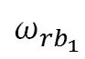



























Properties of a Dominant Sequence
Decreasing sequences can be transformed into non-decreasing sequences with equal or greater demand!
Max. Accel. ($α^{+}$)
Lemma 1 : Dominant sequences do not contain any decreasing subsequences.
Max. Decel. ($α^{−}$)
$$c_{1}$$
$$c_{1}$$
$$ω_{peak}$$
$$c_{2}$$
Var. Accel.
$$c_{2}$$
Lemma 1: Only non-decreasing sequences allowed.
$$ω_{1}$$
$$ω_{0}$$
$$c_{3}$$
$$c_{3}$$
$$c_{4}$$
$$c_{4}$$
$$c_{5}$$
$$c_{5}$$
$$c_{M}$$
$$c_{M}$$
$$ω_{min}$$
$$ω_{{rb}_{1}}$$
$$ω_{{rb}_{2}}$$
$$ω_{{rb}_{3}}$$
$$ω_{{rb}_{4}}$$
$$ω_{{rb}_{5}}$$
$$ω_{max}$$
$$ω_{min}$$
$$ω_{{rb}_{1}}$$
$$ω_{{rb}_{2}}$$
$$ω_{{rb}_{3}}$$
$$ω_{{rb}_{4}}$$
$$ω_{{rb}_{5}}$$
$$ω_{max}$$
Speeds
Speeds
Notes:
Lemma 1 says that

Slide 26




Properties of a Dominant Sequence
Lemma 2 : The first job of a dominant sequence begins at a right boundary.
n jobs in the middle of a step
n jobs at the right boundary speed
Lemma 2: Start at a right boundary speed (RB).
$$c_{m−1}$$
$$c_{m}$$
$$ω_{{rb}_{x}}$$
Same execution time, shorter time
$$↔$$
Notes:
Lemma 2 says

Slide 27








Properties of a Dominant Sequence
Lemma 3 : Dominant sequences have fixed choices for next speeds.
Decision Speed
Option 1 Max. Accel.
$$c_{m−1}$$
$$c_{m−1}$$
Lemma 3: Use maximum acceleration. Additionally, at decision speeds, use variable acceleration to reach RB.
Can release multiple jobs at RB.
Use Max. Accel.
$$c_{m}$$
$$c_{m}$$
$$ω_{{rb}_{x}}$$
$$ω_{{rb}_{x}}$$
When $α^{+}$ travels past right boundary, variable accel. may be used.
Option 2
Single Var. Accel.
$×$ n
RBs Multiple and
Max. Accel.
$$c_{m−1}$$
$$c_{m−1}$$
$$c_{m}$$
$$c_{m}$$
$$ω_{{rb}_{x}}$$
$$ω_{{rb}_{x}}$$
Notes:
Lemma 3 gives us the choice of speeds given the current speed

Slide 28












Dominant Sequence Visualization
Execution Times of the Modes
$$c_{1}$$
$$c_{2}$$
$$c_{3}$$
$$c_{4}$$
$$c_{5}$$
$$c_{M}$$
$$ω_{min}$$
$$ω_{{rb}_{1}}$$
$$ω_{{rb}_{2}}$$
$$ω_{{rb}_{3}}$$
$$ω_{{rb}_{4}}$$
$$ω_{{rb}_{5}}$$
$$ω_{max}$$
Speeds
Notes:
To put the lemmas into context, we will now visualize the dominant sequence

Slide 29





Dominant Sequence Visualization
Max. Accel. ($α^{+}$)
Max. Decel. ($α^{−}$)
$$c_{m−2}$$
$$ω_{peak}$$
Var. Accel.
$$ω_{1}$$
$$ω_{0}$$
$$c_{m−1}$$
$$c_{m}$$
$$ω_{{rb}_{x}}$$
$$ω_{{rb}_{x+1}}$$
Lemma 1: Only non-decreasing sequences allowed.
Lemma 3: Use maximum acceleration. Additionally, at decision speeds, use variable acceleration to reach RB.
Can release multiple jobs at RB.
Lemma 2: Start at a right boundary speed (RB).

Slide 30



A Visual Comparison
$$c_{m−2}$$
$$c_{m−1}$$
$$c_{m}$$
$$ω_{{rb}_{x}}$$
$$ω_{{rb}_{x+1}}$$
$$ω_{{rb}_{x}}$$
$$ω_{{rb}_{x+1}}$$
Sequence in our approach
Sequences in previous work
Search space in our approach is significantly reduced.
Notes:
To put this in perspective, we compare our approach with the DRT approach

Slide 31
Worst-Case Demand as Knapsack
Notes:
We now transform the problem into…

Slide 32



Jobs as Items, Time as Knapsack
ID
Initial Speed,
Final Speed
Item #1
$$ω_{0},ω_{1}$$
Profit
WCET
$ 2
$$c\left(ω_{0}\right)$$
Weight
Min. Interarrival (time)
17 kg
Max 100 sec.
$$\tilde{T}\left(ω_{0},ω_{1}\right)$$
Max 100 kg
Knapsack = Duration of time
32
Notes:
In the traditional knapsack problem….

Slide 33







Transformation Visualization
Execution Times of the Modes
$$c_{1}$$
$$c_{2}$$
0
t
$$c_{3}$$
$$c_{4}$$
$$ω_{j},ω_{k}$$
$$c_{5}$$
$$c_{M}$$
0
t
$$ω_{min}$$
$$ω_{{rb}_{1}}$$
$$ω_{{rb}_{2}}$$
$$ω_{{rb}_{3}}$$
$$ω_{{rb}_{4}}$$
$$ω_{{rb}_{5}}$$
$$ω_{max}$$
Precedence Constraints should be followed too
Speeds
Notes:
Let us visualize the transformation…

Slide 34


















Bounded Precedence Constraint Knapsack Problem
$c(ω_{j})$ – Execution time
$\tilde{T}$ - Job inter-arrival time
BPCKP
$$c(ω_{j})$$
Right boundary speed
$\tilde{T}$($ω_{j}$, $ω_{j}$)
$\tilde{T}$(${ω_{j},ω}_{k}$)
$$c(ω_{j})$$
$$c(ω_{k})$$
Decision Speed
$\tilde{T}$($ω_{j}$, $ω_{j}$)
$\tilde{T}$(${ω_{k},ω}_{l}$)
Middle of a step
$$c(ω_{j})$$
$$c(ω_{l})$$
$\tilde{T}$(${ω_{j},ω}_{k}$)
$\tilde{T}$($ω_{l},ω_{m}$)
$$c(ω_{k})$$
$$c(ω_{m})$$
$\tilde{T}$(${ω_{m},ω}_{n}$)
$\tilde{T}$(${ω_{m},ω}_{o}$)
$$c(ω_{n})$$
$$c(ω_{o})$$
$\tilde{T}$($ω_{n}$, $ω_{n}$)
$$c(ω_{n})$$

Slide 35







$c(ω_{j})$ – Execution time
$\tilde{T}$ - Job inter-arrival time
BPCKP
$$c(ω_{j})$$
$\tilde{T}$($ω_{j}$, $ω_{j}$)
$\tilde{T}$(${ω_{j},ω}_{k}$)
$$c(ω_{j})$$
$$c(ω_{k})$$
$\tilde{T}$($ω_{j}$, $ω_{j}$)
$\tilde{T}$(${ω_{k},ω}_{l}$)
Multiple jobs at RBs –Restricted by the length of the time-interval
$$c(ω_{j})$$
$$c(ω_{l})$$
$\tilde{T}$(${ω_{j},ω}_{k}$)
$\tilde{T}$($ω_{l},ω_{m}$)
$$c(ω_{k})$$
$$c(ω_{m})$$
$\tilde{T}$(${ω_{m},ω}_{n}$)
$\tilde{T}$(${ω_{m},ω}_{o}$)
$$c(ω_{n})$$
$$c(ω_{o})$$
Solve the resultant BPCKP with Dynamic Programming
$\tilde{T}$($ω_{n}$, $ω_{n}$)
$$c(ω_{n})$$
Notes:
We mention that multiple jobs can be released at the right boundary speeds.

Slide 36


Time complexity
Number of Unique Items in Knapsack:
$$O(m\frac{ω_{max}^{2}−ω_{min}^{2}}{2α_{max}})$$
$m$ – number of modes
Search complexity – Pseudo polynomial
Same as any bounded precedence constraint knapsack problem
Notes:
We share a similar complexity when to calculating the number of unique items in the knapsack with the DRT approach.

Slide 37
Evaluation and Results
Notes:
We now move on to the results section

Slide 38


AVR Task Set: Table Comparison
Task Set in Previous Work
$i^{th}$ mode | 1 | 2 | 3 | 4 | 5 | 6 | $$ω_{{rb}_{m}}$$
$$ω_{{rb}_{i}}$$ | 500 | 1500 | 2500 | 3500 | 4500 | 5500 | 6500
$${c(ω}_{{rb}_{m}})$$ | 965 | 576 | 424 | 343 | 277 | 246
$ω_{rb_{i}}$ is reachable from $ω_{rb_{i−k}}$ in integer rotations
Decreases the number of decision speeds
A More Challenging Task Set
$i^{th}$ mode | 1 | 2 | 3 | 4 | 5 | 6 | $$ω_{{rb}_{m}}$$
$$ω_{{rb}_{i}}$$ | 1200 | 2200 | 3200 | 4200 | 5200 | 6200 | 7200
$${c(ω}_{{rb}_{m}})$$ | 965 | 576 | 424 | 343 | 277 | 246
$ω_{rb_{i}}$ is not reachable from $ω_{r−k}$ in integer rotations
Notes:
The problem statement of our approach…

Slide 39










AVR Task Set: Visual Comparison
$$c_{m−2}$$
Previous Work Task Set
# Decision Speeds less than # Modes
$$c_{m−1}$$
Fewer sequences
in the search space
$$c_{m}$$
$$ω_{{rb}_{x}}$$
$$ω_{{rb}_{x+1}}$$
More Challenging Task Set
$$c_{m−2}$$
# Decision Speeds equal to # Modes
$$c_{m−1}$$
More sequences in the search space
$$c_{m}$$
$$ω_{{rb}_{x}}$$
$$ω_{{rb}_{x+1}}$$
Notes:
To visualize this

Slide 40
Algorithm Runtime Comparison
System: Python 3.6.5, 3.4 GHz quad-core processor, 8 GB RAM
Experiment: Calculate worst-case demand for 100 intervals from [0,1s]
 | Previous Task Set | More Challenging Task Set
DRT Alg. | 3 min. 31 sec. | 17 min. 2 sec.
Our Alg. | 15.63 sec. | 19.24 sec.
Performance Improvement | 13.5 | 53.1

Slide 41

Random Taskset Alg. Runtimes

Slide 42

Public Artifact
http://bit.ly/ RTSS18KAVR
Recreate paper results
Customize task sets
Graphical comparison
Python w/ Markdown documentation

Slide 43




Future Work
Relax the symmetric acceleration assumptions
$$α^{−}$$
$$≠$$
$$α^{+}$$
Additional problem dimensions
AVR tasks with different phases
θ
~
Approximation algorithms
Notes:
For future work, we aim to relax the symmetric acceleration assumptions, increase the number of problem dimensions to include things like temperature and pressure, apply approximation algorithms to the knapsack approach, and handle AVR tasks with different phases.

Slide 44





Conclusion
1. Worst-case AVR task demand ↔ Bounded precedence constraint knapsack problem (BPCKP).
↔
2. Symmetric acceleration + Engine kinematics → Reduced search space.
$$α^{−}$$
$$α^{+}$$
→
3. Results significantly outperform the state-of-the-art in computation time.
?
Questions?
sandeepb@vt.edu
aaron.willcock@wayne.edu
tchantem@vt.edu
fishern@wayne.edu
http://bit.ly/RTSS18KAVR
Notes:
"We make a simplifying assumption that magnitude of acceleration and deceleration is equal"

Slide 45
Appendix

Slide 46

Random Taskset Alg. Runtimes (Log)

Slide 47

Rand. Taskset Knapsack Runtimes

Slide 48
Standalone AVR Function
$$c_{1}$$
Execution Times of the modes
$$c_{2}$$
$$c_{3}$$
$$c_{4}$$
$$c_{5}$$
$$c_{M}$$
$$ω_{min}$$
$$ω_{{rb}_{1}}$$
$$ω_{{rb}_{2}}$$
$$ω_{{rb}_{3}}$$
$$ω_{{rb}_{4}}$$
$$ω_{{rb}_{5}}$$
$$ω_{max}$$
c – execution time
$ω$ – angular speed
Speeds
Biondi et al. [ICCPS ‘15]

Slide 49




Why assume $\left|α^{−}\right|=α^{+}$?
$$α^{+}$$
1. How does the problem change when $\left|α^{−}\right|=α^{+}$?
2. Are there non-trivial exploits?
3. What intuitions can we gather about DRT vs BPCKP?
$${|α}^{−}|$$
4. How can we better map the solution space?

Slide 50






But my [insert rotational source] doesn’t have symmetric acceleration!
Increase magnitude of the lesser to match the larger.
$$α^{+}$$
$$α^{−}$$
$$α^{−}$$
$$α^{+}$$
$$α^{−}$$
$$α^{+}$$
Gives pessimistic worst-case demand for the original, asymmetric system.

Slide 51


But my [insert rotational source] doesn’t have symmetric acceleration!
$$α^{+}$$
Imagine a set of asymmetric systems.
Systems where $α^{+}>\left|α^{−}\right|$ artificially raise $\left|α^{−}\right|$.
Systems where $|α^{−}|>α^{+}$ artificially raise $α^{+}$.
$${|α}^{−}|$$
Gives pessimistic worst-case demand for the original, asymmetric system.

Slide 52

How does this compare to actual internal combustion engines?
$$α^{+}$$
Internal Combustion Engine Fundamentals, 2nd Edition by J.B. Heywood
Most internal combustion engines operating without load fall in the highlighted category.
Typically $α^{+}$ >> ${|α}^{−}|$
since friction is the primary cause of ${|α}^{−}|$
$${|α}^{−}|$$

Slide 53
Old Slides

Slide 54
A Visual Comparison
$$c_{m−2}$$
$$c_{m−1}$$
$$c_{m}$$
$$ω_{{rb}_{x}}$$
$$ω_{{rb}_{x+1}}$$
$$ω_{{rb}_{x}}$$
$$ω_{{rb}_{x+1}}$$
Sequence in our approach
Sequences in previous work
Search space in our approach is significantly reduced.

Slide 55


Dominant Sequence Visualization
Max. Accel. ($α^{+}$)
Max. Decel. ($α^{−}$)
$$ω_{peak}$$
$$c_{m−2}$$
Var. Accel.
$$ω_{1}$$
$$ω_{0}$$
$$c_{m−1}$$
$$c_{m}$$
$$ω_{{rb}_{x}}$$
$$ω_{{rb}_{x+1}}$$
Lemma 1: No decreasing subsequence
Lemma 3: Use $α^{+}$ in middle of step.
Use var. accel. or $α^{+}$ at decision speed.
Lemma 2: Start at the right boundary.

Slide 56


Properties of a Dominant Sequence
Lemma 3 : Use $α^{+}$ in the middle of a step. When $α^{+}$ travels past right boundary, variable accel. may be used.
Decision Speed
Option 1 Max. Accel.
$$c_{m−1}$$
$$c_{m−1}$$
$$c_{m}$$
$$c_{m}$$
$$ω_{{rb}_{x}}$$
$$ω_{{rb}_{x}}$$
Option 2a
Single Var. Accel. (don’t stay)
$×$ n
Option 2b Multiple
Var. Accel. (stay)
$$c_{m−1}$$
$$c_{m−1}$$
$$c_{m}$$
$$c_{m}$$
$$ω_{{rb}_{x}}$$
$$ω_{{rb}_{x}}$$

Slide 57


Properties of a Dominant Sequence
Lemma 3 : When $α^{+}$ travels past right boundary, variable accel. may be used.
Decision Speed
Option 1 Max. Accel.
$$c_{m−1}$$
$$c_{m−1}$$
Lemma 3: Use $α^{+}$ in middle of step.
Use var. accel. or $α^{+}$ at decision speed.
$$c_{m}$$
$$c_{m}$$
$$ω_{{rb}_{x}}$$
$$ω_{{rb}_{x}}$$
Option 2a
Single Var. Accel. (don’t stay)
$×$ n
Option 2b Multiple
Var. Accel. (stay)
$$c_{m−1}$$
$$c_{m−1}$$
$$c_{m}$$
$$c_{m}$$
$$ω_{{rb}_{x}}$$
$$ω_{{rb}_{x}}$$

Slide 58
Properties of a Dominant Sequence
Lemma 2 : The first job of a dominant sequence begins at a right boundary.
n jobs in the middle of the step
n jobs at the right boundary speed
Lemma 2: Start at the right boundary.
$$c_{m−1}$$
$$c_{m}$$
$$ω_{{rb}_{x}}$$
Same execution time, more job releases
$$↔$$

Slide 59












Properties of a Dominant Sequence
Lemma 1 : Dominant sequences do not contain any decreasing subsequences.
Max. Accel. ($α^{+}$)
Max. Decel. ($α^{−}$)
Execution Times of the Modes
$$c_{1}$$
$$ω_{peak}$$
Var. Accel.
$$c_{2}$$
$$ω_{1}$$
$$ω_{0}$$
$$c_{3}$$
$$→$$
$$c_{4}$$
$$α^{−}$$
$$α^{+}$$
$$c_{5}$$
$$=$$
$$c_{M}$$
$$ω_{min}$$
$$ω_{{rb}_{1}}$$
$$ω_{{rb}_{2}}$$
$$ω_{{rb}_{3}}$$
$$ω_{{rb}_{4}}$$
$$ω_{{rb}_{5}}$$
$$ω_{max}$$
Speeds
Notes:
Remove the figure on the left

Slide 60
Properties of a Dominant Sequence
Lemma 1 : Dominant sequences do not contain any decreasing subsequences.
Max. Accel. ($α^{+}$)
Max. Decel. ($α^{−}$)
Execution Times of the Modes
$$c_{1}$$
$$ω_{peak}$$
Var. Accel.
$$c_{2}$$
$$ω_{1}$$
Lemma 1: No decreasing subsequence.
$$ω_{0}$$
$$c_{3}$$
$$→$$
$$c_{4}$$
$$α^{−}$$
$$α^{+}$$
$$c_{5}$$
$$=$$
$$c_{M}$$
Decreasing sequences may be transformed into nondecreasing sequences with equal or greater demand.
$$ω_{min}$$
$$ω_{{rb}_{1}}$$
$$ω_{{rb}_{2}}$$
$$ω_{{rb}_{3}}$$
$$ω_{{rb}_{4}}$$
$$ω_{{rb}_{5}}$$
$$ω_{max}$$
Speeds
Notes:
Never go back

Slide 61
Dominant Sequence
Max. Accel. ($α^{+}$)
$$c_{1}$$
Execution Times of the Modes
Max. Decel. ($α^{−}$)
$$c_{2}$$
$$ω_{peak}$$
Var. Accel.
$$c_{3}$$
$$ω_{1}$$
$$ω_{0}$$
$$c_{4}$$
$$>$$
$$>$$
$$c_{5}$$
A dominant sequence is a sequence of job releases which maximizes demand over a time interval $δ$.
$$c_{M}$$
$$ω_{min}$$
$$ω_{{rb}_{1}}$$
$$ω_{{rb}_{2}}$$
$$ω_{{rb}_{3}}$$
$$ω_{{rb}_{4}}$$
$$ω_{{rb}_{5}}$$
$$ω_{max}$$
c – execution time
$ω$ – angular speed
Speeds
Notes:
Only sequences with the properties we’ve proven provide maximal demand. Because of this, we only search for dominant sequences across the range of available speeds.

Slide 62
Dominant Sequence Visualized
Max. Accel. ($α^{+}$)
$$c_{1}$$
Execution Times of the Modes
Max. Decel. ($α^{−}$)
$$c_{2}$$
$$ω_{peak}$$
Var. Accel.
$$c_{3}$$
$$ω_{1}$$
$$ω_{0}$$
$$c_{4}$$
$$c_{5}$$
A dominant sequence is a sequence of job releases which maximizes demand over a time interval $δ$.
$$c_{M}$$
$$ω_{min}$$
$$ω_{{rb}_{1}}$$
$$ω_{{rb}_{2}}$$
$$ω_{{rb}_{3}}$$
$$ω_{{rb}_{4}}$$
$$ω_{{rb}_{5}}$$
$$ω_{max}$$
c – execution time
$ω$ – angular speed
Speeds
Notes:
We prove characteristics of these dominant sequences which guarantee that when compared with one another…

Slide 63
Dominant Sequence Visualized
Max. Accel. ($α^{+}$)
$$c_{1}$$
Execution Times of the Modes
Max. Decel. ($α^{−}$)
$$c_{2}$$
$$ω_{peak}$$
Var. Accel.
$$c_{3}$$
$$ω_{1}$$
$$ω_{0}$$
$$c_{4}$$
$$c_{5}$$
A dominant sequence is a sequence of job releases which maximizes demand over a time interval $δ$.
$$c_{M}$$
$$ω_{min}$$
$$ω_{{rb}_{1}}$$
$$ω_{{rb}_{2}}$$
$$ω_{{rb}_{3}}$$
$$ω_{{rb}_{4}}$$
$$ω_{{rb}_{5}}$$
$$ω_{max}$$
c – execution time
$ω$ – angular speed
Speeds
Notes:
To visualize the need for these sequences, suppose we have three separate sequences. Each sequence with slight variations from the others…

Slide 64









Acceleration Limits (on AVR)
$${α≯α}^{+}$$
$$α^{+}$$
$$α$$
$$ω_{0}$$
$$ω_{1}$$
$$ω_{2}$$
$$ω_{3}$$
$$ω_{4}$$
$$ω_{5}$$
Reachable Speeds

Slide 65
Acceleration Limits (on AVR)
$$c_{1}$$
Execution Times of the Modes
$$c_{2}$$
$$c_{3}$$
$$c_{4}$$
$$c_{5}$$
$$c_{M}$$
$$ω_{min}$$
$$ω_{{rb}_{1}}$$
$$ω_{{rb}_{2}}$$
$$ω_{{rb}_{3}}$$
$$ω_{{rb}_{4}}$$
$$ω_{{rb}_{5}}$$
$$ω_{max}$$
c – execution time
$ω$ – angular speed
Speeds

Slide 66
Conclusion
Engine kinematics → Reduced search space
Worst-case AVR demand ↔ BPCKP
Results significantly outperform the state-of-the-art.

Slide 67
Conclusion
Engine kinematics → Reduced search space
Worst-case AVR demand ↔ BPCKP
Results significantly outperform the state-of-the-art.
Questions?

Slide 68
Stages of a typical 4-stroke Engine of a Car
Exact quantity and the precise instant to inject the fuel for optimal performance of the engine is to be calculated.
Spark-Ignition
Cylinder
Intake Valve
Fuel/Air Mix
Exhaust Valve
Piston
Piston
Rod
θ
θ = 180°
θ = 0°
Crank Angle
Crank
a) Intake
b) Compression
c) Combustion
d) Exhaust
Bottom Dead Center
Top Dead Center

Slide 69
AVR Tasks – Speed or WCET?
$$c_{1}$$
+ Allows WCET to scale inversely with speed
? How can we calculate worst-case demand?
Execution Times of the modes
$$c_{2}$$
$$c_{3}$$
Higher rate of job release
Higher WCET per job release
$$c_{4}$$
$$c_{5}$$
Higher rate of job release
Higher rate of job release
$$c_{M}$$
$$ω_{min}$$
$$ω_{{rb}_{1}}$$
$$ω_{{rb}_{2}}$$
$$ω_{{rb}_{3}}$$
$$ω_{{rb}_{4}}$$
$$ω_{{rb}_{5}}$$
$$ω_{max}$$
c – execution time
$ω$ – angular speed
Speeds
Biondi et al. [3]

Slide 70

AVR Task
$$c_{1}$$
Execution Times of the modes
c – execution time
$ω$ – angular speed
$$c_{2}$$
AVR tasks allow WCET to scale inversely with speed
Higher WCET per job release
$$c_{3}$$
$$c_{4}$$
$$c_{5}$$
Higher rate of job release
Higher rate of job release
$$c_{M}$$
$$ω_{min}$$
$$ω_{{rb}_{1}}$$
$$ω_{{rb}_{2}}$$
$$ω_{{rb}_{3}}$$
$$ω_{{rb}_{4}}$$
$$ω_{{rb}_{5}}$$
$$ω_{max}$$
Speeds

Slide 71

Worst-case AVR Task Demand
Where do we start?
Where do we go?

Slide 72
Digraph Real-Time (DRT) Approach
+ Exact worst-case demand
− Searches unnecessary sequences

Slide 73

Engine Control Modules (ECMs)
Motivation:
Responsibilities:
Fuel injection
Spark ignition
Top-Dead-Center:
Real-time job release
Due at next ignition
Existing calculations of exact worst-case demand for AVR tasks are compute intensive.
Problem Statement:
Calculate the exact worst-case demand of an AVR task over a time interval $δ$.
Image Provided by: Zephyris.
https://commons.wikimedia.org/wiki/
File:4StrokeEngine_Ortho_3D_Small.gif
Notes:
ECM Responsibilities

Slide 74
Engine Control Modules (ECMs)
Responsibilities:
Fuel injection
Spark ignition
Prevent ECM Overload:
Due at next ignition
Image Provided by: Zephyris.
https://commons.wikimedia.org/wiki/
File:4StrokeEngine_Ortho_3D_Small.gif
Notes:
ECM Responsibilities

Slide 75
Engine Control: Adaptive Variable-Rate (AVR) Tasks
$$c_{1}$$
Execution Times of the modes
$$c_{2}$$
Right boundary speeds
$$c_{3}$$
Higher rate of job release
More time between jobs
$$c_{4}$$
$$c_{5}$$
Higher rate of job release
More computation per job
$$c_{M}$$
$$ω_{min}$$
$$ω_{{rb}_{1}}$$
$$ω_{{rb}_{2}}$$
$$ω_{{rb}_{3}}$$
$$ω_{{rb}_{4}}$$
$$ω_{{rb}_{5}}$$
$$ω_{max}$$
Speeds
Notes:
1. Add a legend about c and \omega

Slide 76

Engine Control: Adaptive Variable-Rate (AVR) Tasks
$$c_{1}$$
Higher rate of job release
Execution Times of the modes
More time between jobs
$$c_{2}$$
Right boundary speeds
$$c_{3}$$
Higher rate of job release
More computation per job
$$c_{4}$$
$$c_{5}$$
$$α^{−}$$
$$α^{+}$$
$$c_{M}$$
$$ω_{min}$$
$$ω_{{rb}_{1}}$$
$$ω_{{rb}_{2}}$$
$$ω_{{rb}_{3}}$$
$$ω_{{rb}_{4}}$$
$$ω_{{rb}_{5}}$$
$$ω_{max}$$
Speeds
Notes:
Add a legend about c and \omega
“Now that we have the nature of the AVR task, we have to calculate the worst-case demand”
“Difficult because…”

Slide 77

Motivation & Problem Statement
$$c_{1}$$
Motivation:
Execution Times of the Modes
Existing calculations of exact worst-case demand for AVR tasks are compute intensive.
$$=$$
$$c_{2}$$
$$c_{3}$$
$$c_{4}$$
Problem Statement:
$$c_{5}$$
Calculate the exact worst-case demand of an AVR task over a time interval $δ$.
$$c_{M}$$
$$ω_{min}$$
$$ω_{{rb}_{1}}$$
$$ω_{{rb}_{2}}$$
$$ω_{{rb}_{3}}$$
$$ω_{{rb}_{4}}$$
$$ω_{{rb}_{5}}$$
$$ω_{max}$$
Speeds

Slide 78
Engine Control: Adaptive Variable-Rate (AVR) Tasks
$$c_{1}$$
Higher rate of job release
Execution Times of the modes
More time between jobs
$$c_{2}$$
Right boundary speeds
$$c_{3}$$
Higher rate of job release
More computation per job
$$c_{4}$$
$$c_{5}$$
$$α^{−}$$
$$α^{+}$$
$$c_{M}$$
$$ω_{min}$$
$$ω_{{rb}_{1}}$$
$$ω_{{rb}_{2}}$$
$$ω_{{rb}_{3}}$$
$$ω_{{rb}_{4}}$$
$$ω_{{rb}_{5}}$$
$$ω_{max}$$
Speeds
Notes:
1. Add a legend about c and \omega

Slide 79












ECM Real-Time Tasks
Calculations:
Fuel-Air Mixture
Spark Advance
Problem:
Engines accelerate, decelerate
0
$$T_{1}$$
$$2T_{1}$$
$$3T_{1}$$
$$4T_{1}$$
$$\frac{dθ}{dt}$$
θ
$$T$$
$$Number of jobs released$$
0
$$T_{2}$$
$$2T_{2}$$
$$3T_{2}$$
$$4T_{2}$$
$$5T_{2}$$

Slide 80

Trivial Solution
Schedule the jobs of the ECM tasks at the highest speed
Requirement of other tasks $≤$ Remaining resource availability
System is not always operated at the highest speed
Under Utilized!!!
Notes:
Suggested merger with.

Slide 81


Worst-case AVR Task Demand
Maximum Speed
Say the number of jobs released is ‘n’ in time ‘t’.
$$Demand=c\left(ω_{max}\right)∗n$$
Execution Times of the modes
$$c_{1}$$
$$c_{2}$$
$$c_{3}$$
$$c_{4}$$
Not Minimum Speed
Right Boundary Speed of the first Mode
‘m’ jobs are released.
$$Demand=c\left(ω_{min}\right)∗m$$
$$c_{5}$$
$$c_{M}$$
$$ω_{min}$$
$$ω_{{rb}_{1}}$$
$$ω_{{rb}_{2}}$$
$$ω_{{rb}_{3}}$$
$$ω_{{rb}_{4}}$$
$$ω_{{rb}_{5}}$$
$$ω_{max}$$
Speeds
Calculation of Worst Case Demand is not straightforward.

Slide 82
Worst-case AVR Task Demand
$$c_{1}$$
Where do we start?
Execution Times of the Modes
Where do we go?
$$c_{2}$$
$$c_{3}$$
$$c_{4}$$
$$c_{5}$$
$$c_{M}$$
$$ω_{min}$$
$$ω_{{rb}_{1}}$$
$$ω_{{rb}_{2}}$$
$$ω_{{rb}_{3}}$$
$$ω_{{rb}_{4}}$$
$$ω_{{rb}_{5}}$$
$$ω_{max}$$
Speeds
Notes:
Use this to transform timeline to knapsack items

Slide 83
Demand of AVR Tasks
$$c_{1}$$
Execution Times of the modes
$$c_{2}$$
$$c_{3}$$
$$c_{4}$$
Calculation of Worst Case Demand is not straightforward.
$$c_{5}$$
$$c_{M}$$
$$ω_{min}$$
$$ω_{{rb}_{1}}$$
$$ω_{{rb}_{2}}$$
$$ω_{{rb}_{3}}$$
$$ω_{{rb}_{4}}$$
$$ω_{{rb}_{5}}$$
$$ω_{max}$$
Speeds
Notes:
These are real-time tasks which model the behavior of engine control tasks.
As engine speed increases, time between jobs decreases and WCET decreases.

Slide 84
Properties of a Dominant Sequence
Lemma 1 : Dominant sequences do not contain any decreasing subsequences.
Max. Accel. ($α^{+}$)
Max. Decel. ($α^{−}$)
Execution Times of the modes
$$c_{1}$$
$$ω_{peak}$$
Var. Accel.
$$c_{2}$$
$$ω_{1}$$
Decreasing sequences may be transformed into nondecreasing sequences with equal or greater demand.
$$ω_{0}$$
$$c_{3}$$
$$→$$
$$c_{4}$$
$$α^{−}$$
$$α^{+}$$
$$c_{5}$$
$$=$$
$$c_{M}$$
$$ω_{min}$$
$$ω_{{rb}_{1}}$$
$$ω_{{rb}_{2}}$$
$$ω_{{rb}_{3}}$$
$$ω_{{rb}_{4}}$$
$$ω_{{rb}_{5}}$$
$$ω_{max}$$
Speeds

